Slide 1
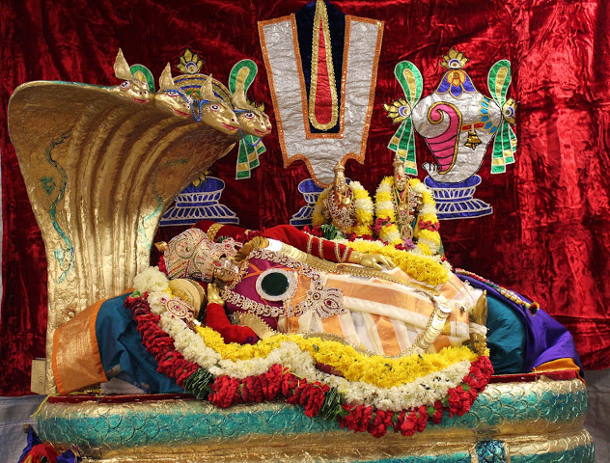
Sri Venkateswara Swamy Temple of Colorado

Slide 2
Glance at 2016 Financials

Slide 3
Loans Status as of Q1 2014
Mortgage $1,329,198
Private loans
$867,892
Pending Interest Payment
$70,000
Total
Liabilities
$2,267,090

Slide 4
Balance Sheet as of Dec. 2013
* CPA prepared Balance Sheet.

Slide 5
Current Loans Status (as of Oct. 2016)
Mortgage $1,236,030
Private loans
$619,078
Pending Interest Payment
$20,000
Total
Liabilities
$1,875,108
$391,982 Reduction in Liabilities in last three years ($130K average / Year).
Legal and Settlement expenses: $160K.
Could have been reduced our debt by additional $160K.

Slide 6
Balance Sheet as of Oct. 2016
* CPA prepared Income statement.

Slide 7
Financial status since Jan 2014
Interest paid-off 2012, 2013, 2014 and 2015 | $120,000
Short term loans paid off | $215,000
Loan conversion to pledge (approx.) | $55,000
**Not including interest paid to the bank on our loan

Slide 8
How did we do this?
Highlights
Converted member loans to donations
Reduced operating expenses, thus achieving more savings
Fund Raising events
More devotees traffic to temple – thus increase in donations (in Hundi collections)
Increase in at home and at temple priest services / sponsorships
Increase in prasadam and Annadam donations
etc.

Slide 9
Who helped us?
All volunteers
All committee chairs / members
A big thank you to all volunteers who helped to reduce the temple debt, create a pleasant environment and finally a sustainable future !!!!

Slide 10
Next 24 months goals & targets
Raise additional $750,000 by End of December 2018.
Pay-off all member loans.
180-days
360-days
540-days
Continue
$250K
$400K
$600K
$750K
Pay-off the member loans and plan for new infrastructure projects.
Start immediately. Continue fund raising for future temple development.

Slide 11
How !
We have 3500 registered devotees in our system
> 35% increase in devotees traffic since 2014
Last year average donations > $250 pledged from only 300 Members
If we can tap in to rest of the 3000 devotees and increase pledge by at least $200 an average by family
3000 X $200 = $600000
We already have a sustainable income to operate Temple and we are in healthy condition
So, to my fellow founding members, my request is: communicate positive message to your friends and families. Please do not send negative message/s to anyone saying that temple cannot sustain in the future !!!! You’re completely incorrect and you’re not helping the temple!!!!

Slide 12
2017 Budget

Slide 13
Religious Committee Annual Report Committee Members Sri Satyanarayana Velagapudi Sri Venkateswara Rao Bandla Sri Ramesh Chatari Sri Srinivasulu Gude Sri Siva Rayala Smt Smitha Thurimella Sri Madhusudhan Rao K Sri Sreenivasa Rao Katamaneni Sri Peddabbayachary Madupu Sri Raghavendar Reddy Mamudur

Slide 14
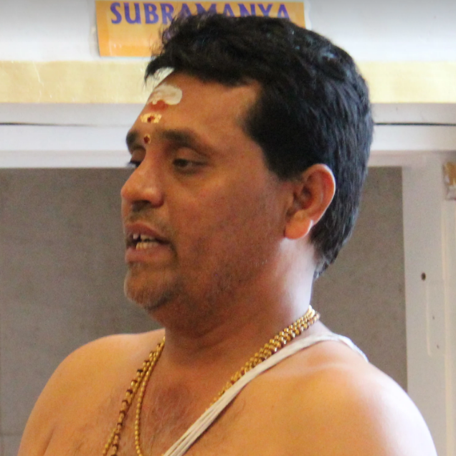
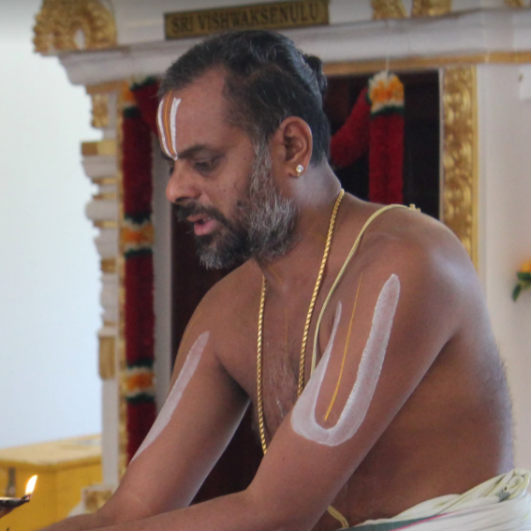
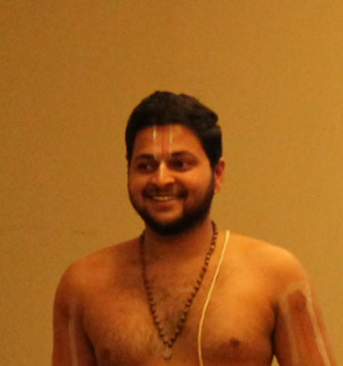
Religious Committee Annual Report Our Priests
Sri Karanam Krishnamohan Swamy
Sri Rajagopalan Viengimoore Swamy
Sri Manikanta Swamy
Priests well versed in
Telugu
Tamil
Kannada
Malayalam
Hindi
Priests well Trained in
Pancharatra Agama
Smartha Agama
Well versed in rituals

Slide 15
Religious Committee Annual Report Temple Scheduled Services (Daily and Monthly) SRI VENKATESWARA SUPRABHATA SEVA SRI VENKATESWARA NITYA ARCHANA SRI SATYANARAYANA SWAMY POOJA AND VRATAM SRI VENKATESWARA SWAMY ABHISHEKAM (Moola murthy) SRI MAHALAKSHMI ABHISHEKAM (Moola murthy) SRI VENKATESWARA SWAMY KALYANAM NAVA GRAHA POOJA SRI ANDAL ABHISHEKAM (Moola murthy) SRI SHIVA ABHISHEKAM SRI SHIRDI SAI BABA and SRI RAGHAVENDRA SWAMY ABHISHEKAM SRI HANUMAN ABHISHEKAM SRI VIJAYA GANAPATHI AND SRI VALLI DEVASENA SAHITHA MURUGAN ABHISHEKAM SRI SUDARSHANA HOMAM

Slide 16
Religious Committee Annual Report Festivals/Annual Events New Year Day Celebrations Ratha Sapthami Vasantha Panchami Bheeshma Ekadasi Maha Sivarathri Ugadi Celebrations Tamil New Year Sri Rama Navami Sri Hanuman Jayanthi AkshayaTritiya Sri Ramanuja Jayanthi Sri Lakshmi Narasimha Jayanthi

Slide 17
Religious Committee Annual Report Festivals/Annual Events Sri Annamacharya Jayanthi Celebrations Gurupurnima Celebrations Varalakshmi Vratam Sri Krishna Janmastami Celebrations Ganesh Chathurdhi Celebrations Sri Venkateswara Jayanthi Celebrations Mahalaya Amavasya Dussehra (Vijayadashami) Celebrations Deepavali Celebrations Karthika Maasa Shiva Abhishekam, Deeparadhana Skanda Shasti Celebrations Karthika Pournami Deepa Pooja

Slide 18
Religious Committee Annual Report Special Events Sri Ahobilam Ramanuja Jeeyar Swamiji Visit Sri Rama Paduka Pattabhishekam Nakshatra Shanti Homam Sani Trayodasi Celebrations (2/6,2/20,6/2, 11/12, 11/26) Performed Sani Trayodasi on all trayodasi days which falls on Saturday. Discourse on Bhagvath Gita and Srimad Bhagavatam by Dr Ghanakota Venkata Sastri

Slide 19
Religious Committee Annual Report Special Events Sri Chandi Yagam Chandi Homam, Kanya Suvasini Puja Tritiya Vaarshika (3rd annual) BRAHMOTSAVAM Celebrated for 5 days with different puja services. Ekaahnika Visesha Siva Parivaarotsavam First time celebrated Shiva Parivarotsavam. Sri Mahalakshmi Laksha kumkumarchana Kumkumaarchana by Devotees - 5 batches of 20 families each Lakshmi Kubhera Pasupatha Homam

Slide 20
Religious Committee Annual Report Thank You A big thanks to all the team members for their dedication and commitment. Special thanks to Sri Ramesh Chatari for his help in performing rituals. Thanks to Priests for their dedicated service. Thanks to BOT for giving the opportunity to serve as committee member. Thanks to General Body members for their support.

Slide 21
Religious Committee Annual Report Questions / Feedback / Comments If you have any questions or feedback/comments please email religiouscommittee@svtempleco.org. We appreciate your feedback/comments to improve services at the temple and at home.

Slide 22
Religious Committee Annual Report Need Help Religious committee needs help in the following areas. Please come forward and join the team. Floor volunteers for monthly events. Festival/Special event coordinators. Floor volunteers for Festival/Special events. If you are interested please contact religious committee @ religiouscpmmittee@svtempleco.org

Slide 23
Q & A
May the Lord of Seven Hills and Padmavathi Ammavaru shower their blessings on all of us.

Slide 24
Web & Communications Committee Objectives Email Communication Website Maintenance Facebook Updates Multimedia Support

Slide 25
Web & Communications Committee Committee Members Sri. Saiganesh Rajamani – Email (Special events) Smt. Smitha Thurimella – Email (Weekly Events) Sri. Manmohan Dronamraju – Website Updates Sri. Ravichandran Packirisamy – Facebook & Photo / Video Suresh Kommula – Facebook Sri. Srinivas Panthangi - Photo/Video

Slide 26
Web & Communications Committee Communication / Multimedia Tasks Send weekly and special event emails (Mobile phone friendly). Around 3000 devotee emails in our distribution. Website updates, calendars and site maintenance Added new TV at the temple to support live telecast of events / upcoming events / temple website. Replaced existing analog surveillance data recorder and cameras (15) with new HD recorder and HD cameras.

Slide 27
Web & Communications Committee Communication / Multimedia Tasks Provide photo and video coverage of all major events and cultural events. Update TV slides with event flyers and Annadanam list. Media coverage – Send Photos and edited videos to TV channels for coverage.

Slide 28
Web & Communications Committee Areas to improve Website Redesign Implement online event registration and pooja scheduling.

Slide 29
Web & Communications Committee Thank You Team!! A big thanks to all my team members for their time and commitment.

Slide 30
Web & Communications Committee Questions / Feedback / Comments If you have any questions or feedback/comments please email communications@svtempleco.org. We appreciate your feedback/comments to improve communication, website, and multimedia.

Slide 31

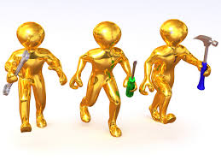

2016- SVTC Facilities and Maintenance Committee
Chair: Ravichandran Packirisamy
Aaron Brachfeld
Achary Madupu
Lakshmipathy Kannan
Ratnakar Kalangi
Ravichandran Packirisamy
Siva Rayala
srinivas panati
Srinu panthangi
Venkata Giri Ginjupalli

Slide 32
team Responsibilities:
Schedules housekeeping duties
Determines and schedules any repairs, waste reduction improvements and safety inspections.
Performs minor landscaping, plumbing, electrical and building maintenance work.
Advise SVTC management for cleaning supplies
Troubleshoot and repair any mechanical, electrical and plumping failure.

Slide 33


Regular - Building Maintenance
Recertify building
1. Annual - Fire extinguisher inspection -Recertified
2. Annual - Elevator - Recertified
3. Annual - Fire sprinkler systems - Recertified
Reset building temperature
Schedule and monitor water quality inspection
Annual - County Fire Department - Fire inspection

Slide 34


Major upgrade :
More Signs
Installed Baby Changing Table
Landscape - Spring Tulips
Replaced Temple (2)Entrance Board
New Window Curtains
Replaced existing Curtains
Installed new TV

Slide 35

Major Issue:
Kitchen Water leak/Broken Disposal
Broken Security Camera
Yaga sala (Yagam) Smoke
Parking(lot) Issue
Storage Issue
Parking Lot Electric(Light) Panel Issue
Bathroom – Sink faucets Issue
Broken dishwasher
Refrigerator- Freezer Issue

Slide 36


Major Contribution
Build Yaga sala
Brahmotsavam
Pavithrotsavam
Main floor – Cleaning Work
Landscape work - Keep Clean
Donated Lawn Mover – Lawn Moving/Landscaping Work
Snow Removal
Work with all the committee and facilitate necessary maintenance/repair work

Slide 37



Under development :
Green House Project
Fund raised ( Over $ 6k)
Storage Shed
Fund raised ( Over $ 3k)
Permanent ‘Mother’s place’/ Changing Room
Automatic Gate Opener
More Signs
New Notice Board
Expand Parking Lot – Need Funding

Slide 38



Achievement - Page 1
Maintain Cleanliness inside the building
Maintain all vahanas
Inspect/Maintain Vimana Gopuram / Temple Roof
Upgrade Security Camera (Fund raised $ 5k)
Cleaned Ground level (Saved $1750.00)
Lawn Moving Work (Saved Each Time $350)
Repaired electric, plumbing work
Repaired Kitchen Gas Stove burner problem
Fixed Street Light
Regular check up on Refrigerator Cleanness
Ordered Cleaning supplies

Slide 39
Achievement - Page 2
Schedules Recycling
Road Cleaning - Ridge Road / Plum Creek Pkwy
Organized Storage Shed – Build Loft
Installed Bathroom hand holds (Sponsored)
Maintain Key Log List
Tree Maintenance

Slide 40

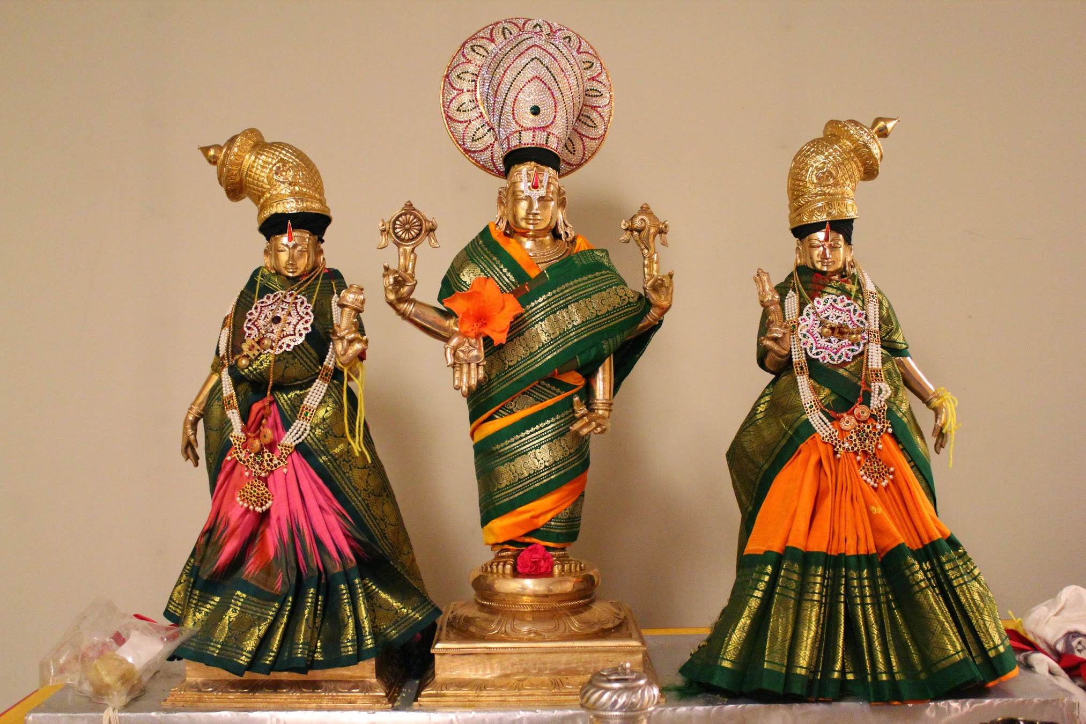

SRI VENKATESWARA TEMPLE OF COLORADO
2016
ANNAPURNA
COMMITTEE
REPORT

Slide 41
2016 MAJOR EVENTS
NEW YEAR’S DAY
UGADI
SRI RAMA NAVAMI
CHANDI HOMAM
BRAHMOTSAVAM
PAVITHROTHSAVAM
ANNAKOODA UTSAVAM
VINAYAKA CHATURTHI
NAVARATHRI
DEEPAVALI

Slide 42
2016 EVENT HIGHLIGHTS
500+ devotees were fed a traditional kalyanam meal on Sri Rama Navami. Special thanks to Chef Prabhakar garu for his help.
Annadhaanam is being continued during every Kalyanotsavam, Brahmotsavam and Pavithrotsavam as per temple policy.
Annakooda utsavam was initiated this year by Sri Rajagopala Bhattar and all devotees were fed 7 varieties of prasadham.
Deepavali brought in a large crowd and funds as well.

Slide 43
2016 REVENUE AND EXPENSES
Revenue from laddu sales and kitchen are approximately 40,000 +
Expenses for the kitchen are under 4000 for the entire year

Slide 44
2016 COMMITTEE MEMBERS
Special thanks to priest Sri Karanam Krishna Mohan swamy and the volunteers for their help extended to the Annapurna Committee.
Smt. Vasanthi Budumgunta
Smt. Sujatha Devamadhavan
Smt. Parvathi Donthula
Smt. Munni Kalagara
Smt. Sandhya Karamsetty
Smt. Madhavi Katamaneni
Smt. Lakshmi Koneru
Smt. Manorama Kuna
Smt. Pallavi Kutty
Smt. Nishanti Lakshmipathy
Smt. Sailaja Malisetty
Smt. Sushma Mamindlapalli
Smt. Madhuri Mohan
Sri. Naveen Murthy
Smt. Suneatha Mushini
Smt. Soumya Nandireddy
Smt. Madhavi Panati
Sri. Karthikeyan Santhanam
Smt. Smitha Thurimella
Smt. Usha Velagapudi

Slide 45
GOALS AND ACHIEVEMENTS
ACHIEVEMENTS:
Reorganization of Pantry.
Increased number of Volunteers.
More diversified food.
Extra charge for to go boxes.
Whats App group created for effective communication between volunteers.
GOALS:
Maintain cleanliness in pantry and kitchen.
Increase participation from all the committee members.
Keep track of income generated by Annapurna committee.

Slide 46


Education & Cultural Committee
Team
Nandu Sankaran
Aruna Madala
Madhavi Panati
Madhavi Katamaneni
Rajeshwari Mahalingam
Gowri Nandakumar
Geetha Saiganesh
Meena Venkateshwaran

Slide 47
SVTC SCHOOL OF FINE ARTS
The SVTC School Of Fine Arts Is Committed To Promoting Hindu Arts and Culture by Organizing Various Classes

Slide 48
Accomplishments
Three Kuchipudi Students completed Arangetram
Two Bharatanatyam Students have completed the Certificate Course from the Alagappa University, India
Two Bharatanatyam Dance Students are planning the Arangetram next year
One Student completed the Tamil Language Advanced Exams from the Tamil Virtual University, India
Students learning Vocal Carnatic Music have won many awards in the Colorado State competitions organized by CFAA
Students learning Vocal Carnatic Music and Mridangam are now doing many concerts
Total Revenue is $21,000. (Profit $9000)
Goodwill

Slide 49
Issues
Teachers Resignation
Number Of Students
Payment To The Temple By The Teachers
New Temple School Students Not Taken By the Teachers

Slide 50
Future Plans
Hire Only Teachers Who Work On a Voluntary Basis
Charge A Minimum 20% Of The Fee Collected
Teachers Will Directly Collect The Fees From The Students
Explore The Possibility Of Conducting The Classes At The Temple
Music/Dance workshops During The Summer Vacation
Bajans and Shlokams Classes At The Temple

Slide 51
SVTC School Income (Month Wise)

Slide 52
SVTC School Expenses

Slide 53
Students By Teacher
Teacher Students Revenue Donation
Arunkumar 4 $300 100 %
Mohana 7 $420 50%
Mala Raghu 5 $350 50%
Sudha Ramesh 8 $700 0%

Slide 54
CULTURAL COMMITTEE
Cultural Programs (Monthly & Major)
Discourses
Lectures

Slide 55
Accomplishments
Cultural programs for the Monthly events (Venkateshwara Abhishekam)
Fund Raiser Dance/Workshop by Ms Savitha Sastry (we made about $5000 profit)
Dance workshop by Pavithra Bhat
Dance event by Ms Suhasini (Kuchipudi Margam)
Annamacharya day Cultural program
Cultural Programs for the Brahmothsavam
Discourse by Swami Chidatmananda "Strategy for Success“
Discourse by Samavedam Shanmuga Sharma “Hanuman Chalisa Mahatmiyam”

Slide 56
Future Plans
Organize Fund Raiser Cultural Programs With The Local Talent
Organize Fund Raisers/Workshops By Professional Artists
Cultural Programs For The Other Monthly Events (Srinivasa Kalyanam, Shiva Abhishekam)
Organize Discourses and Lectures

Slide 57

Cultural & Education Committee
Thanks You Very Much For Your Support

Slide 58

Om Namo Venkatesaya Sri Venkateswara Swamy Temple of Colorado
Managers Report
AGBM – Dec 11 2016

Slide 59
Getting very positive feedback from devotees on the services we are providing at the temple
Temple is open on time everyday and devotee attendance has increased a lot over last year
Priests instructed to treat all devotees equally and make them feel welcome
Priests to strictly follow their schedules, take prior permissions for any deviations, start events on time
Priests get live updates on private puja schedules on their smart phones
Private puja requests have gone up significantly. This year we have performed 410 private pujas as of December 10th and funds raised by such services has crossed $77K
Devotees are pleased that our priests can do last rites and anniversaries, we have performed 55 such rituals this year

Slide 60

Om Namo Venkatesaya Sri Venkateswara Swamy Temple of Colorado
Fund Raising Committee
Members
All BOT Members
Sri Sreedhar Donthula (Chair)

Slide 61
Accomplishments in 2016
Granite Wall drive
22 founding members increased their pledge /Converted loans to donations
Total money raised by this drive: > $85k
Big thanks to Babu Rao Garu for his relentless efforts in making this happen
Donar Wall drive
12 devotees increased their contributions
Total money raised by this drive: > $16k
New Life members (contributions combine >= $15k) added by this drive: 3
Sita Svayamvaram Kuchipudi Dance ballet
Big thanks to Laya Dance academy for undertaking this initiative
Total new money raised by this drive: $10k

Slide 62
Goals for 2017
Add 50 Monthly recurring Donors
Donors can enroll using paypal online on the http://svtempleco.org
Raise $100k in new money
Using Donor wall, new Pooja services, special projects
Make the temple debt free

Slide 63
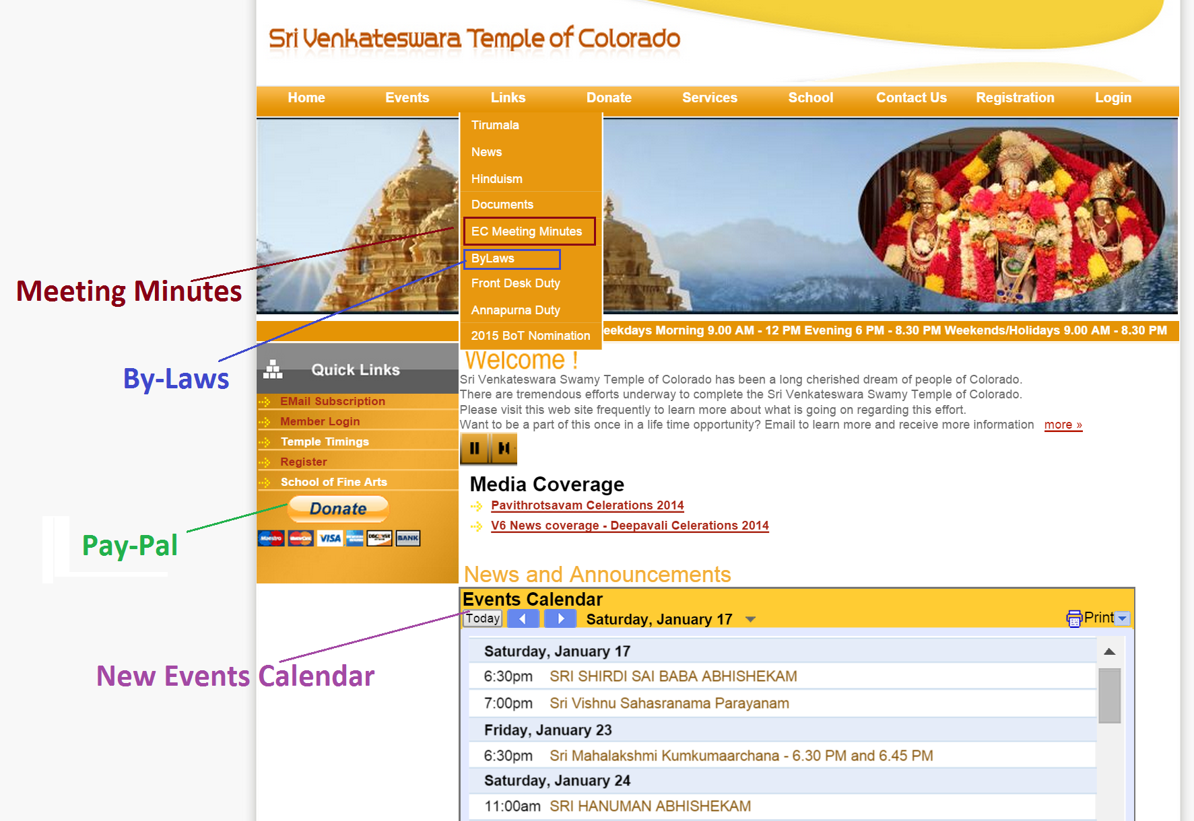
Please donate online – Thank you

Slide 64
Gopuram Update Ramki Thurimella

Slide 65
Granite Wall Update Baburao Karamsetty

Slide 66
Legal Matters

Slide 67
Q & A

